Slide 1
IRIS PROJECT

Slide 2
Contents of This Template
# Look At The Big Picture - Classification - Supervised - Batch Learning - Model Based #1 Get The Data - Importing the required libraries -Read The Data -Features #2 Discover the Data. -Data Information -Describe the data - Data cleaning
#3 Visualize the Data.
-Data analysis(pair plot) -Describe the visualization -Face Grid -Histogram -Correlation -Univariate Plots #4 Prepare the Data for Machine Learning Algorithms
- Handling Text and Categorical Attributes
-X,y
-Feature Scaling
-Splitting the data
#5 Select and Train a Model
-Decision Tree Classifier
-Logistic Regression
- Support Vector classifier (linear kernel)
- Support Vector classifier (RBF kernel)
-K Neighbors Classifier
- Random Forest Classifier
- Gaussian NB
-100.000%

Slide 3
Introduction
In this project, we will build a machine learning model to predict the species of an iris using the measurements based on a given labeled dataset. we will walk through the different steps of the building process: exploring, visualizing and cleaning the data. Then, selecting the best model and model evaluation.

Slide 4
# Look At The Big Picture
problem? Classification
Type of machine learning system?
Supervised / Unsupervised
Batch Learning / Online Learning
Instance Based / Model Based

Slide 5
01
Get The Data

Slide 6
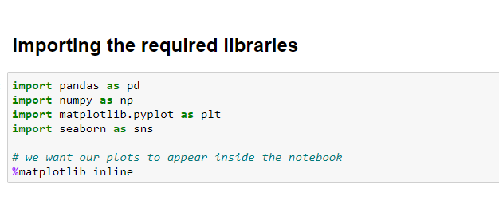
Importing the required libraries

Slide 7
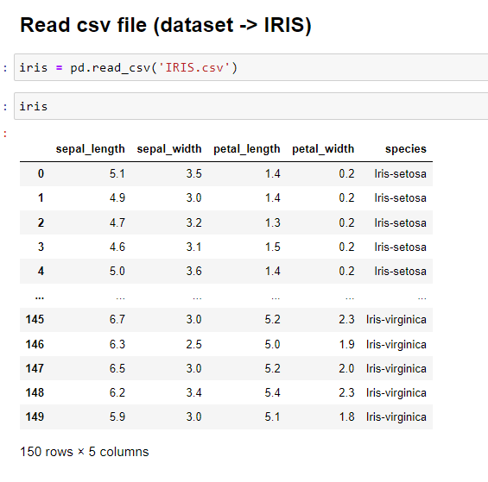
Read The Data

Slide 8
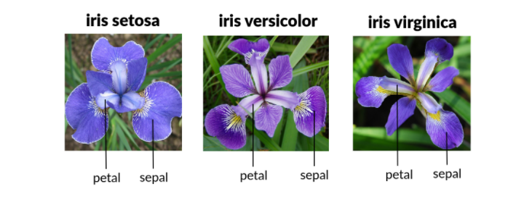
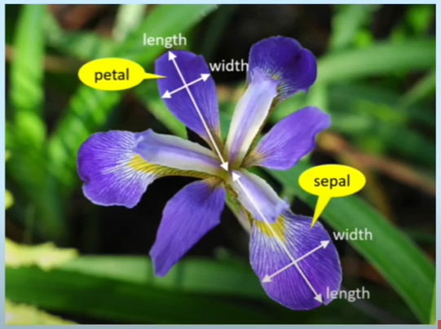
Features
# 1.sepal length in cm
# 2.sepal width in cm
# 3.petal length in cm
# 4.petal width in cm
# 5.class:
# a.-- Iris Setosa
# b.-- Iris Versicolour
# c.-- Iris Virginica
Features
# The Iris Dataset consists of (50)samples each of three different species of iris flower: setosa, versicolor and virginica.
# It contains four different measurements for each sample in centimetres the length and width of sepals and petals - making it a multivariate dataset.

Slide 9
02
Discover the Data

Slide 10
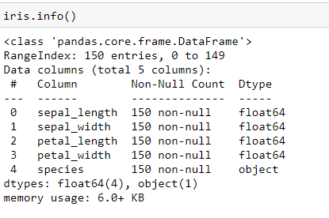
Data Information
- Notice that there are 150 values in the data set. - There is no null values. - All data is numeric except the species its categorical data.

Slide 11
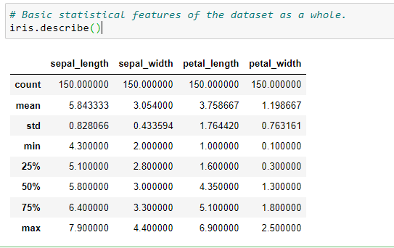
Describe the data summary of the numerical attributes
- All the numerical values have the same scale (centimeters) and similar ranges between 0 and 8 centimeters.

Slide 12
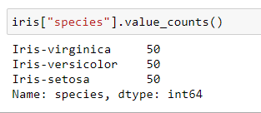
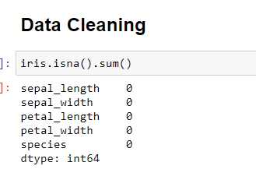
- Data cleaning Check if there are any missing values.
- Value_counts() to know how many flowers of the species there are.

Slide 13
03
Visualize the Data

Slide 14
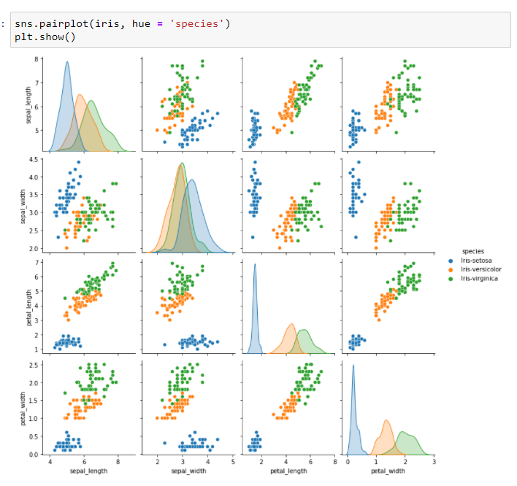
Data Analysis
- Initial visual observation of the measurements and relationships between them.
pairplot

Slide 15
# It may be beneficial at this stage to visualize the data # and the relationships between measurements to see # if any patterns emerge. # For this I utilized a seaborn pair plot , # which pairs every feature with every other feature, # distinguished by object-type. # A pair plot outputs a mixture of two-dimensional scatter plots, # that show the relationships between measurements, # and univariate histograms that show the distribution # of each measurement separated by species. # Straightaway we can see that iris setosa (blue) appears visually to # be quite separate from the other two species in virtually all # scatter plot feature combinations, # but most drastically in petal measurements. # While there is quite a bit of observable overlap between versicolor (orange) # and virginica (green), particularly in terms of sepal measurements, # setosa appears to be significantly linearly distinct. # Petal length and width and sepal length in the setosa are significantly smaller # than those of either versicolor or virginica, # as we can see in the histograms where the setosa data is much closer # to the left of each graph.
Describe the visualization

Slide 16
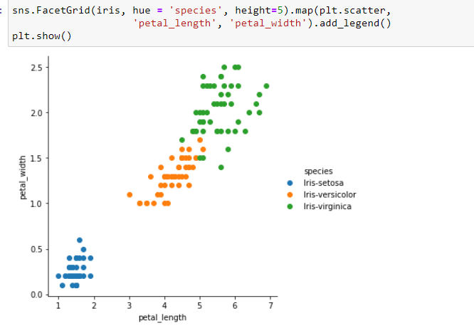
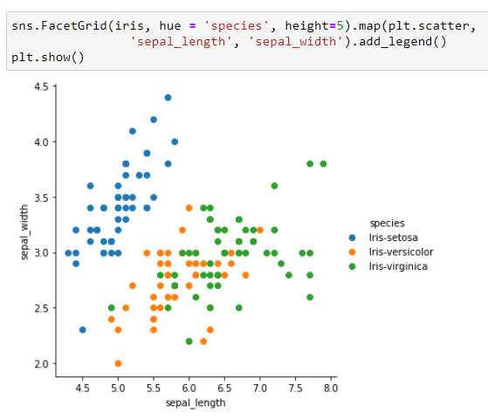
Closer look at scatter plots for petal measurements .
Face Grid
Closer look at scatter plots for sepal measurements
.

Slide 17
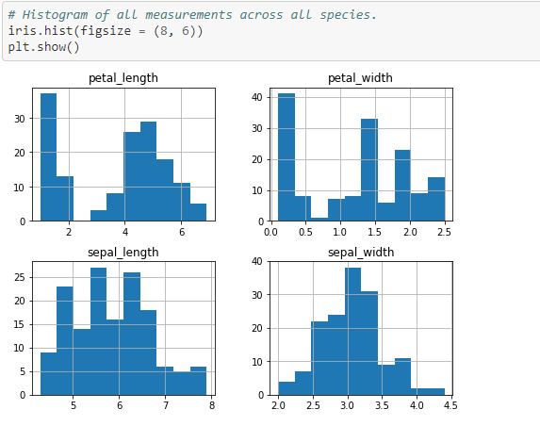
Histogram
-We can also create a histogram of each input variable
to get an idea of the distribution.

Slide 18
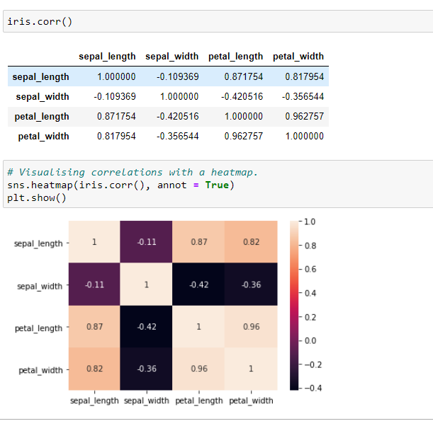
Correlations between measurements.

Slide 19
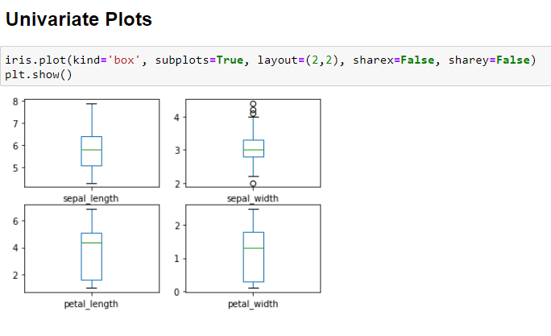
Univariate Plots
-This gives us a much clearer idea of the distribution of the input attributes:
-we can find the : Q1 , Q2=MEAN , Q3 , OUTLIERS , IQR = Q3-Q1 .

Slide 20
04
Prepare the Data

Slide 21
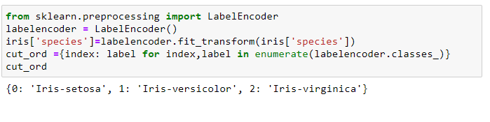
Handling Text and Categorical Attributes
Iris-setosa | 0
Iris-versicolor | 1
Iris-virginica | 2

Slide 22
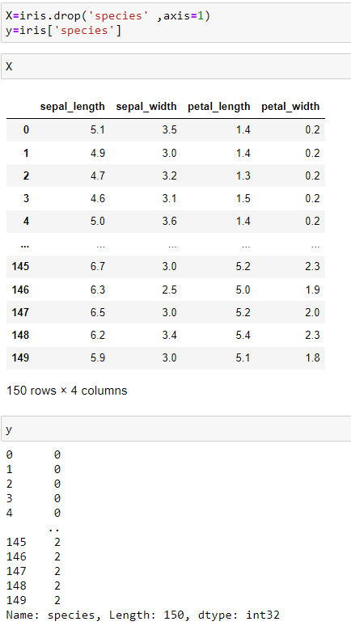
X,y
let’s separate the
predictors(species(dependent
variabl[y])) and the other attributes ( independent variable[X])

Slide 23
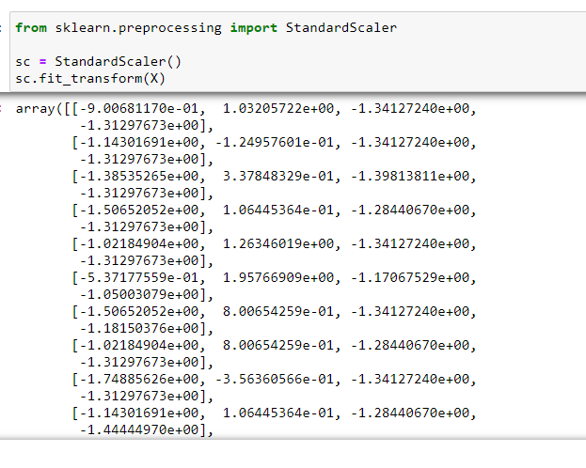
Feature Scaling
- We scale the data to be in the same range.

Slide 24
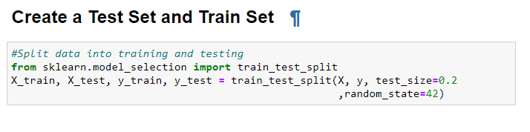
Splitting the data
- Split the dataset into 80% training and 20% testing.

Slide 25
05
Select and Train a Model

Slide 26
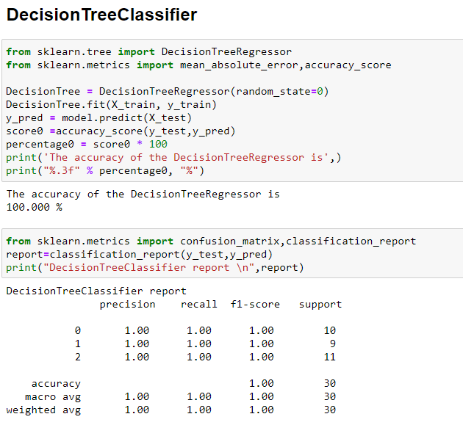
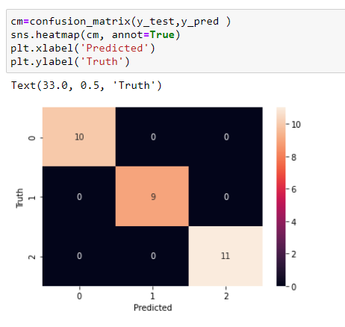
Decision Tree Classifier
confusion_matrix
classification_report

Slide 27
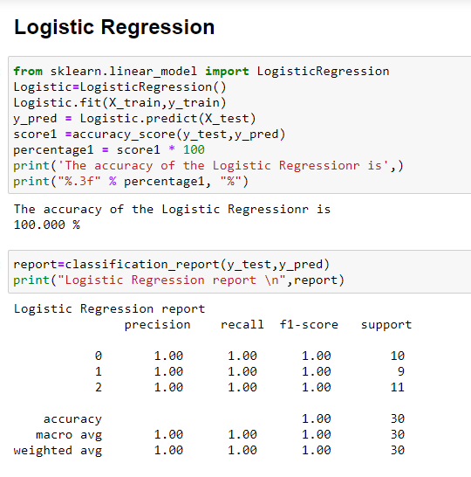
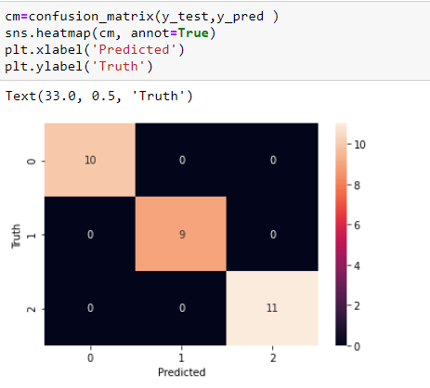
Logistic Regression
confusion_matrix
classification_report

Slide 28
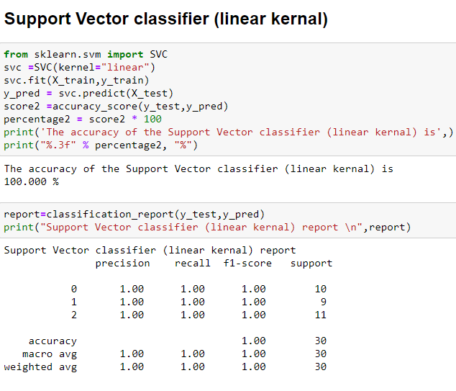
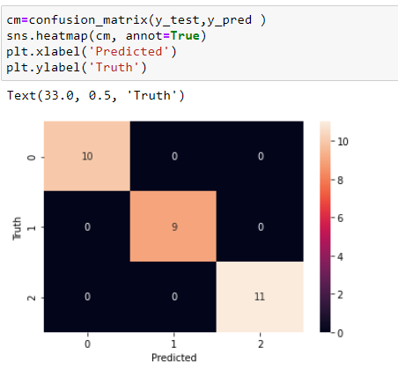
Support Vector classifier (linear kernel)
confusion_matrix
classification_report

Slide 29
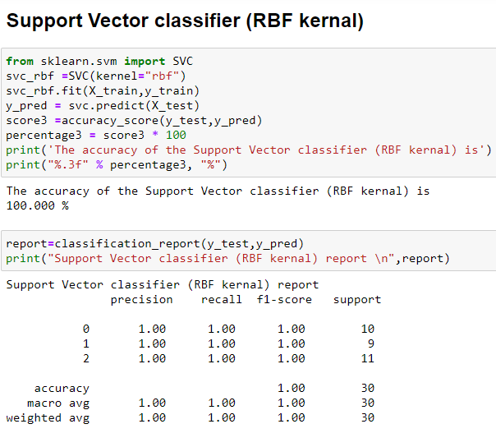
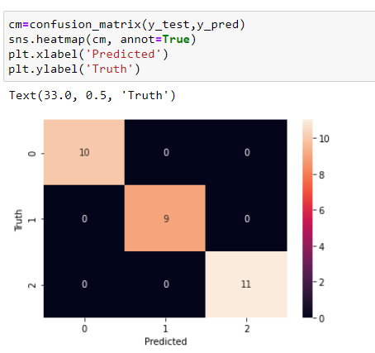
Support Vector classifier (RBF kernel)
confusion_matrix
classification_report

Slide 30
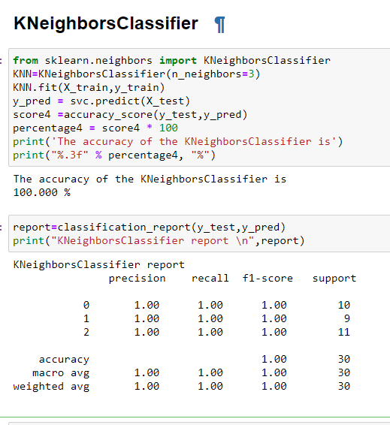
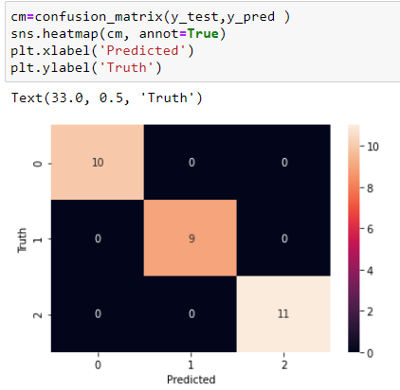
K Neighbors Classifier
confusion_matrix
classification_report

Slide 31
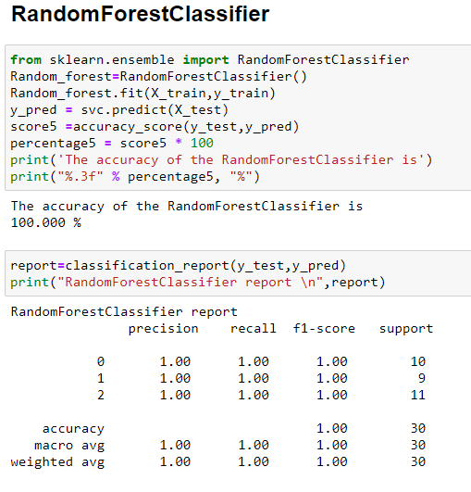
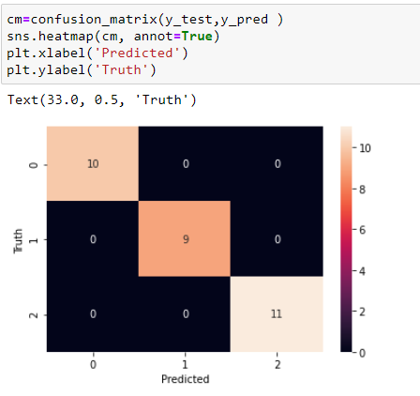
Random Forest Classifier
confusion_matrix
classification_report

Slide 32
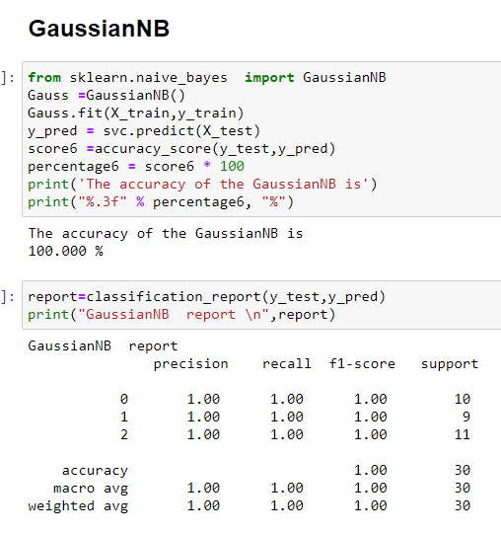
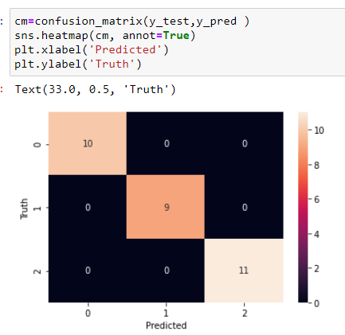
GaussianNB
confusion_matrix
classification_report

Slide 33
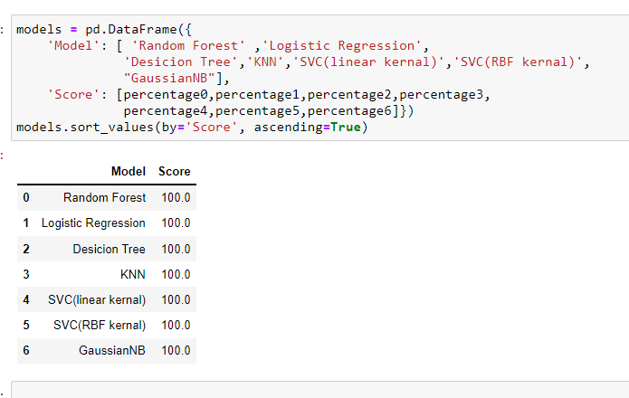
We applied 7 models on data
and we noticed that all the model get accuracy=100.000%.

Slide 34
Thanks!
Rama Al-Marahlh

